Slide 1


Product Profile
Digital Venture Solutions (Z) Ltd

Slide 2




Key Features
K
Affordable
Flexible
Efficient
Comprehensive
Scalable

Slide 3
Discussion on 24th July 2022
Module based Pricing…
Each module is different and needs to discussed.
Integration with existing solutions..
Integrate existing modules
API
Excel
CSV
Add data security / encryption

Slide 4
Employee Management
Employee Lifecycle
Leave and Attendance
Shift Management
Expense Claims and Advances
Hiring
Performance Management
Fleet Management
Training
Payroll
Taxation
Compensation
Analytics

Slide 5
Document Management and Workflows
Requirement | Odoo | ERPNext | ERPNext+
Document Storage | Y | Y | Y
OCR | Y | Y | Y
Full Text Search | Y | N | Y
Additional Tags to Documents | Y | Y | Y
Document Versioning | Y | N | Y
Workflow | Y | Y | Y
Signing the document | Y | Y | Y

Slide 6
Modules
Digital Venture Solutions (Z) Ltd

Slide 7








Asset Maintenance & Management
Human Resource & Payroll
Management
Accounting (Opt)
Sales & Distribution Management
Purchase Management
Inventory Management
Production Management
Client Relationship Management (Opt)

Slide 8
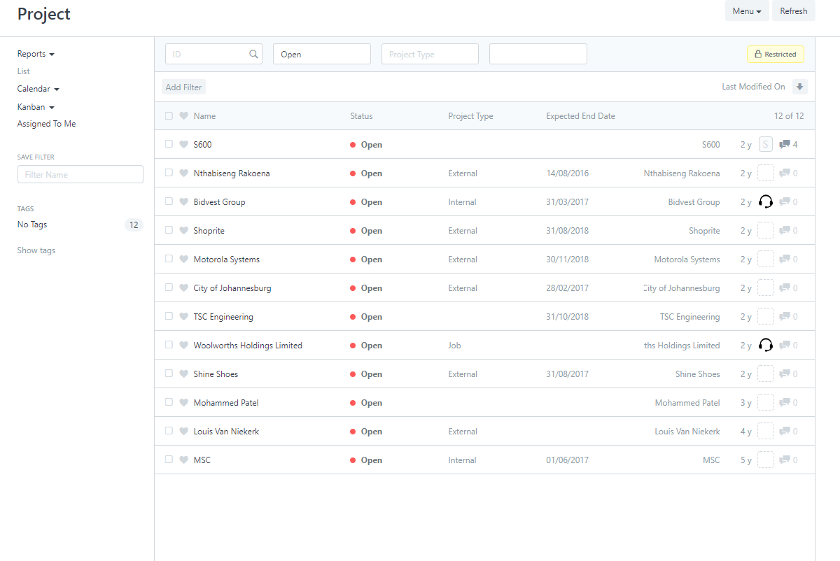






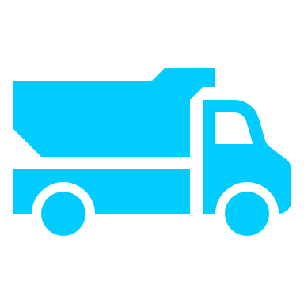



Add-on Modules
ERPNext is a customizable solution for specific needs. Add-on modules which are being delivered are
Quality Control
Project Management
Doc. Management
& Workflows
After Sales Support
Fleet Maintenance & Management
Websites
Reporting
Notes:
Quality Control management
After Sales Support
CRM
Fleet maintenance & Management
Project Management
Document management & Work flow Solutions
Websites

Slide 9
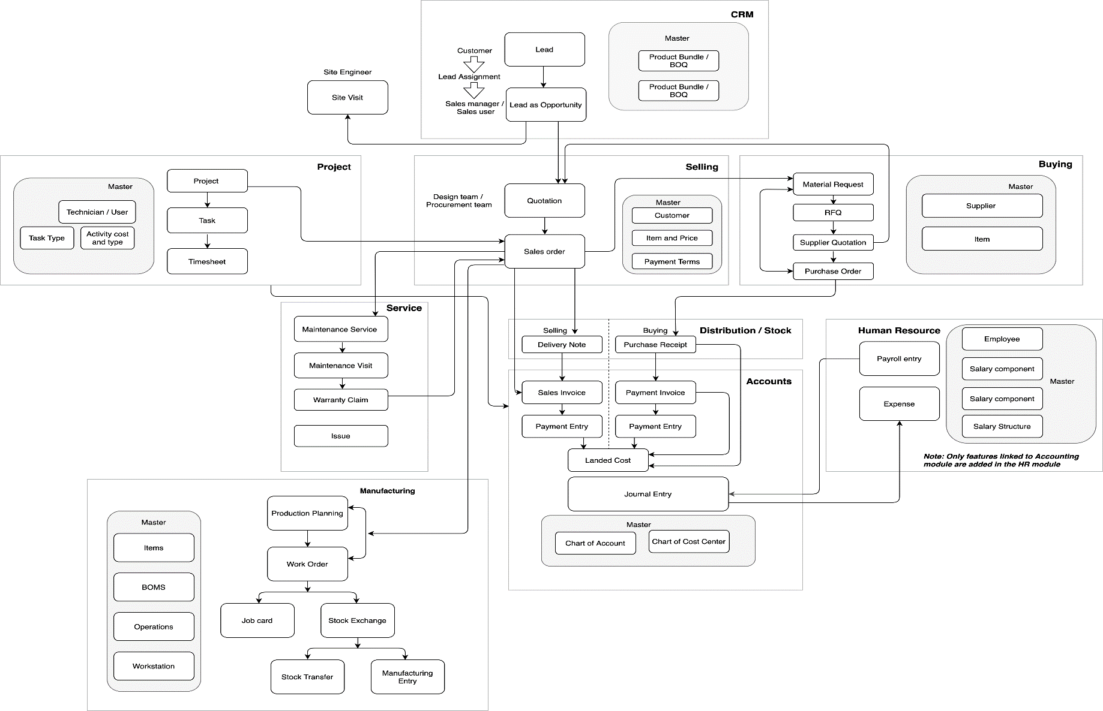
Workflows

Slide 10
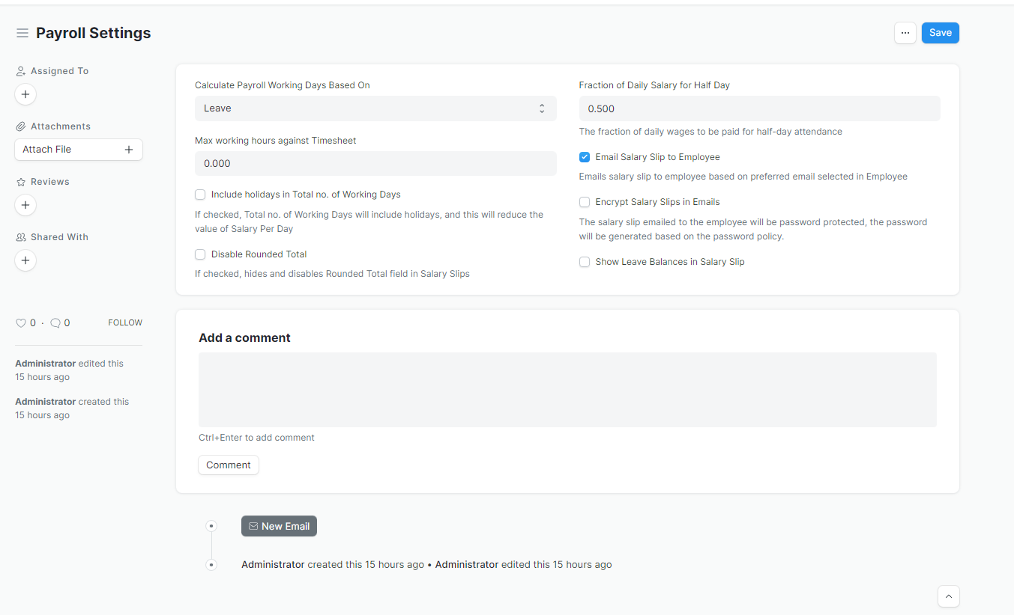
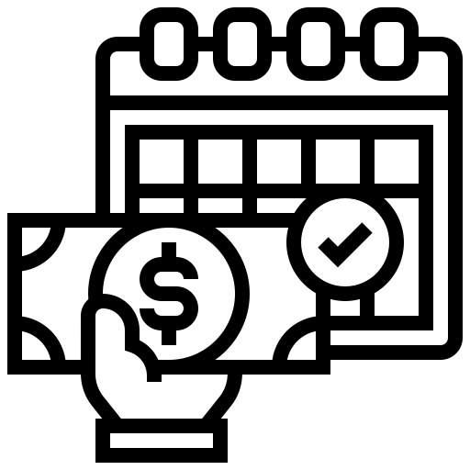



Payroll & Leave Management
Performance
Recruitment
HR & Payroll Management
Payroll processing is an important function of every enterprise HR. ERPNext greatly simplifies this process by offering an array of features that you can utilize from Salary Structure management to bulk processing Payroll of employees.

Slide 11
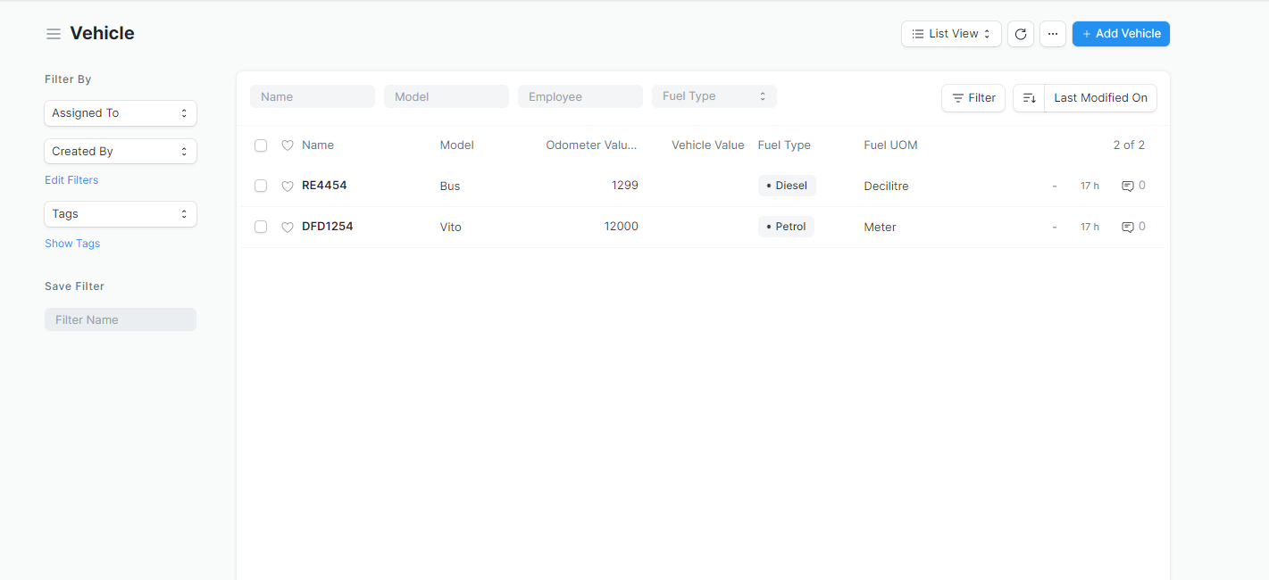


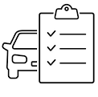

Vehicle Management
Fuel Consumption
Compliance
Fleet Management
Fleet management can enable a real-time view of vehicle movement and location, driver performance, fuel consumption and potential delays. It can ensure compliance with regional driving regulations before the start of a trip.
Notes:
Asset management, inventory, Pos, fleet management

Slide 12
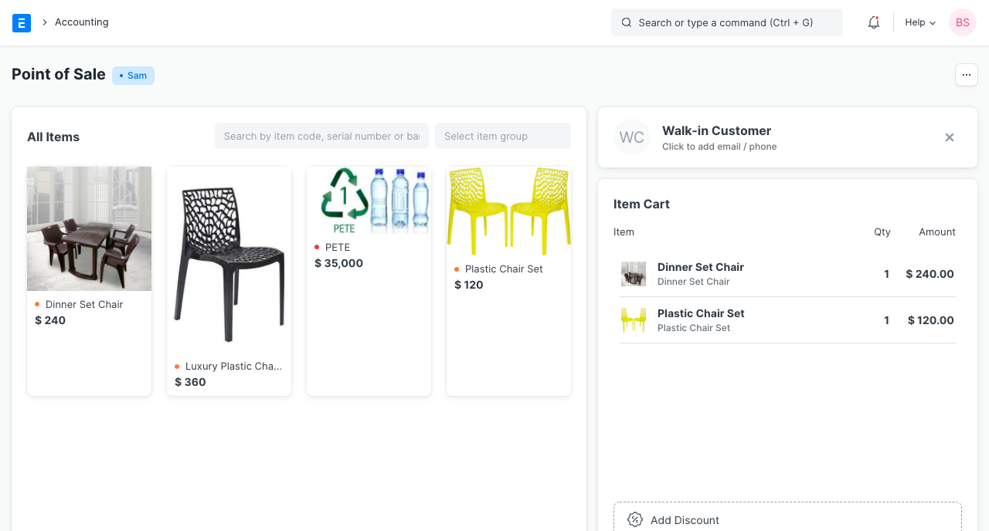

Tracking Sales
Planning Inventory
Compliance
Point of Sale
… Let’s Discuss …
Notes:
Asset management, inventory, Pos, fleet management

Slide 13
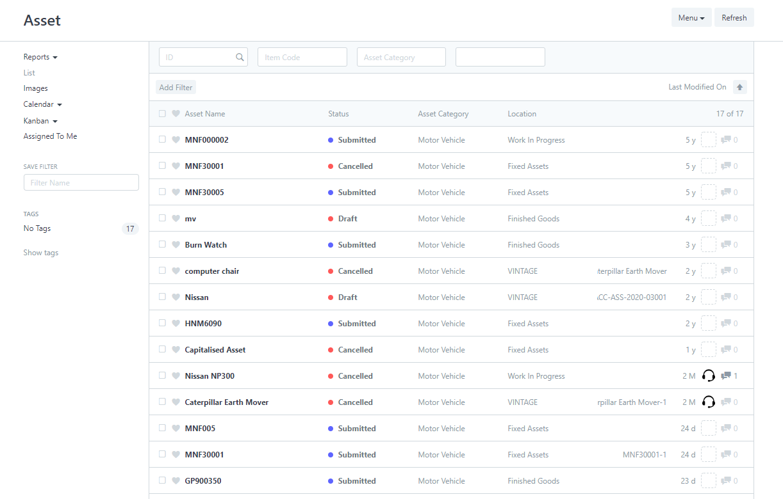


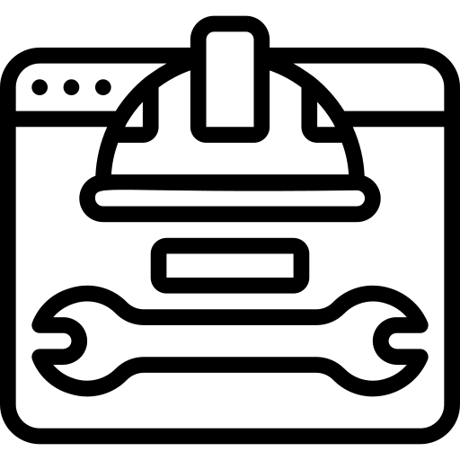

Manage Asset
Save Money
Maintenance and service scheduling
Asset Maintenance and management
Asset management manages the lifecycle of assets to maximize their use; save money; improve quality and efficiency; and safeguard health, safety and the environment.

Slide 14
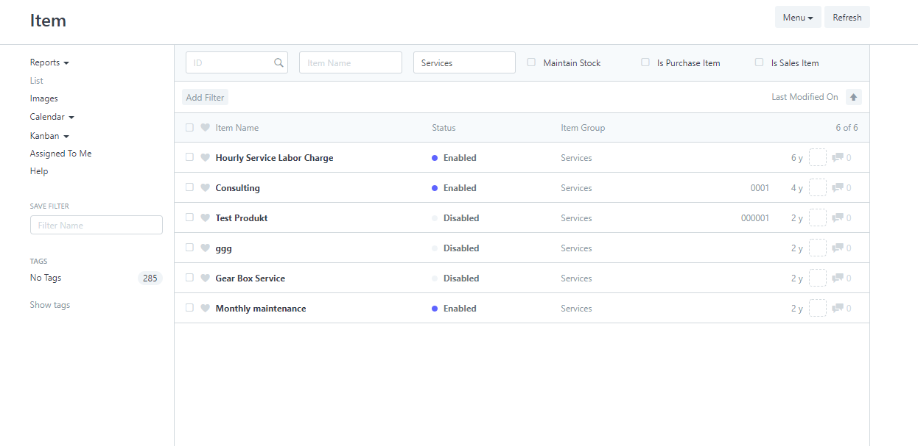



Warehouse Management
Stock Tracking
Manage PO / Sales Orders
Inventory Management
Define entire inventory with item-wise rates while maintaining the level of inventory optimal for requirements.

Slide 15
Industries
Digital Venture Solutions (Z) Ltd

Slide 16
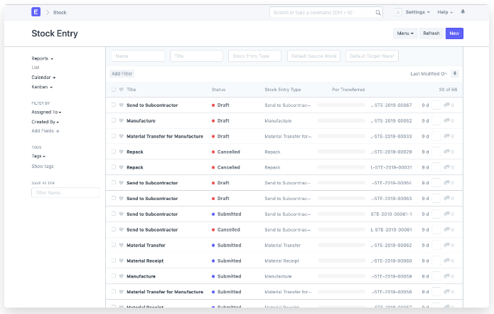


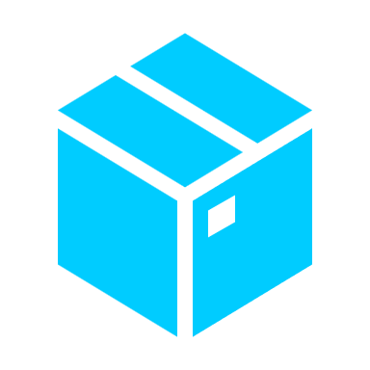







Bill Of Material
Shop Floor Management
Batched Inventory
MANUFACTURING
An open source, modern cloud manufacturing ERP software that simplifies the production cycle, helps track material consumption, exhibits capacity planning, handles subcontracting, and more!
Multi Lingual
Material Resource planning
Serialized Inventory
Capacity Planning

Slide 17
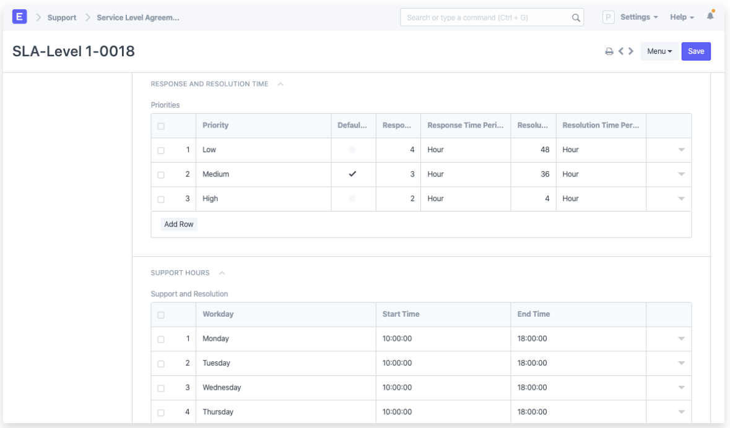






Manage Customers
Campaigns
Project Management
SERVICES
Run your services business better with ERPNext. Know your leads and customers, set up subscription plans for your services, build rapport with regular customers using a loyalty program, manage and bill multiple projects, set up maintenance schedules and visits, and much more.
Multi Lingual
Help Desk
Accounting
Billing &
Pricing

Slide 18
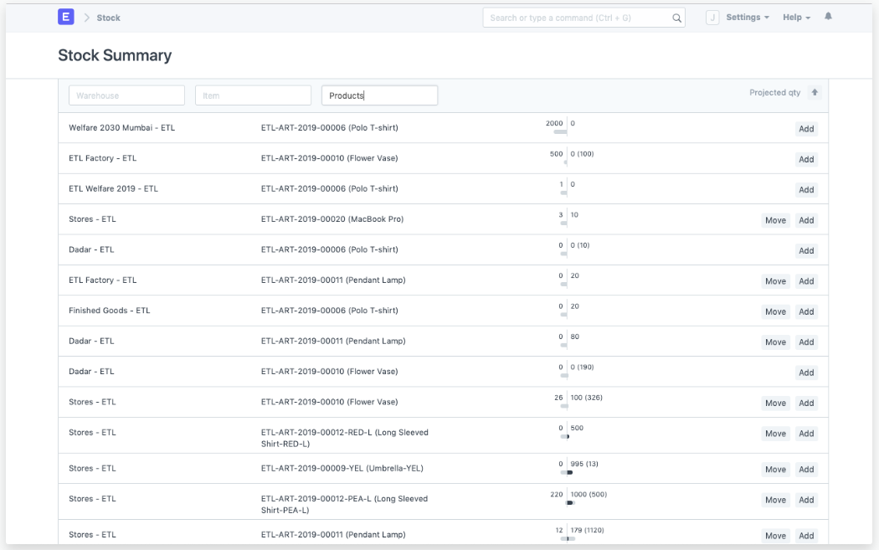






Multi-store Management
Promotional Schemes
Multi-channel Sales
DISTRIBUTION
Intelligently track order fulfillment, reduce incorrect inventory procurement, control stock levels, apply promotional schemes and simplify your distribution business. Set up and integrate your Amazon, WooCommerce, or Shopify account, and start selling your merchandise.
Multi Lingual
Credits & Receivables
Multi-Currency Accounting

Slide 19
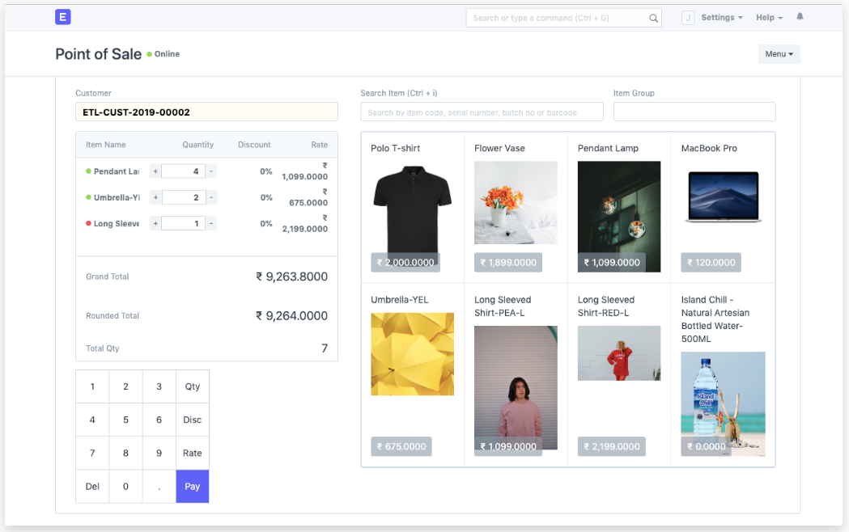



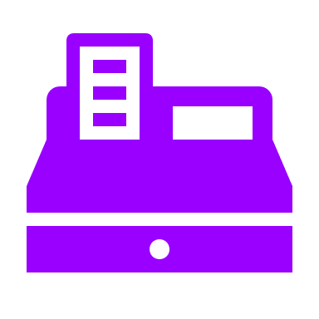

Stock
Customer Acquisition and Loyalty
RETAIL
Measure, manage and sell more with a comprehensive cloud solution to help you streamline retail management, track inventory, manage customers, and increase business profitability.
Multi Lingual
Multi-store Retail Management
Billing &
Pricing

Slide 20
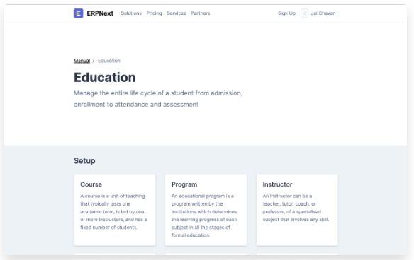







Learning Management System
Receipt
Document Storage
EDUCATION
ERPNext is an open source, modern, DIY ERP software for educational institutes and schools. It helps schools of any size to manage students, teachers, courses, and academic programs with an interactive portal built on our platform, all out of the box.
Multi Lingual
Student Attendance
Programs and Courses
Student Information

Slide 21

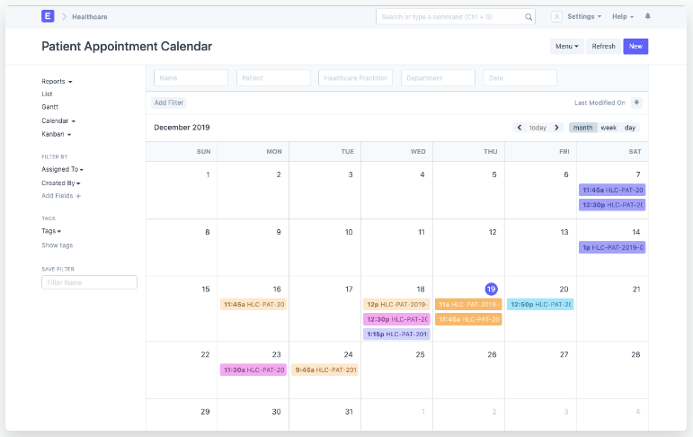





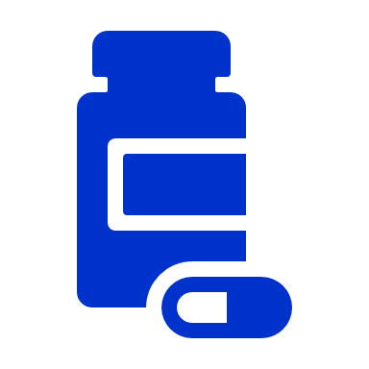


Patient Repository
Healthcare Practitioners
Practitioner Schedule
HEALTHCARE
ERPNext is an open, modern, DIY ERP software for hospitals, clinics, and dispensaries.
Multi Lingual
Prescriptions
Patient Appointments
Medicine & Equipment's
Billing & Pricing

Slide 22
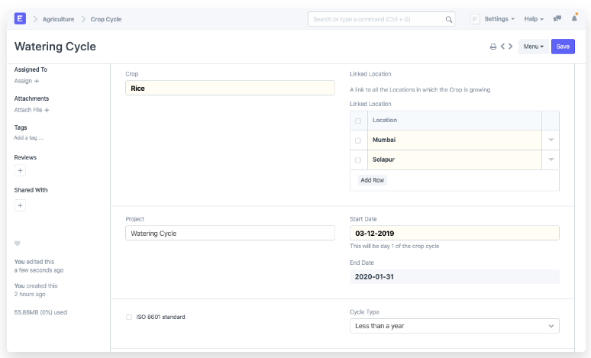








Manage Crop
Manage Fertilizers
Plant Analysis
AGRICULTURE
Manage your agriculture business with features for recording and tracking crop cycles, locations, diseases, and fertilizers.
Multi Lingual
Water Analysis
Weather Analysis
Sales & Purchase

Slide 23
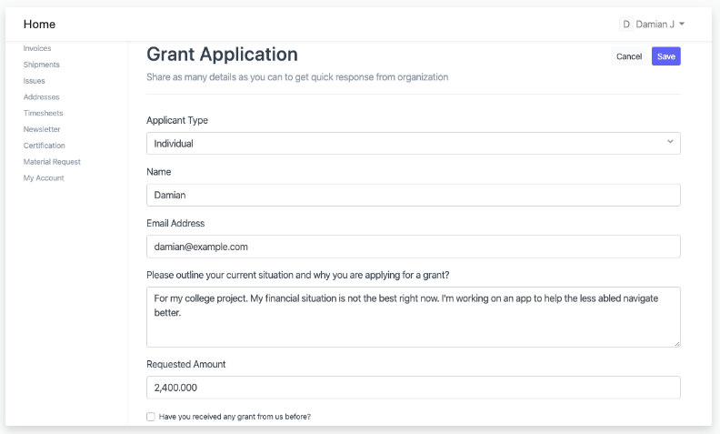





Donor
Volunteer
Members
NON PROFIT
Run your nonprofit organization smoothly by tracking members, memberships, volunteers, donors, and grant applications.
Multi Lingual
Multi-Currency Accounting
Billing &
Pricing

Slide 24
Customers
Digital Venture Solutions (Z) Ltd

Slide 25
Customer Success Stories
The Stock Balance and Stock Summary report helped indicate the stock present at each warehouse. These reports leveraged analysis of inventory and helped Meru Greens Horticulture make informed decisions about their inventory storage or availability.
ERPNext is actually better than we hoped for, I am impressed with what it can do with basic setup before getting into customization.
- Wolf Components Ltd
By utilizing the built-in formula based Salary Component and Salary Structure in ERPNext, it was easy to set up a Kenyan Payroll that works with no additional customizations. Furthermore, shift management was very handy for managing shifts in the factory of the organization.
Sapcon Instruments used ERPNext Inventory, Supply Chain & Website to manage their business operations seamlessly to meet the explosive demands of their growing business.
ERPNext is a single software to manage your accounts, inventory, receivables, payables, taxation, payroll, jobs, CRM, and after-sales services. ERPNext’s flexibility, along with a comprehensive user interface, makes it user friendly.
– Genfocus electrical equipment

Slide 26
Appendix
Digital Venture Solutions (Z) Ltd

Slide 27
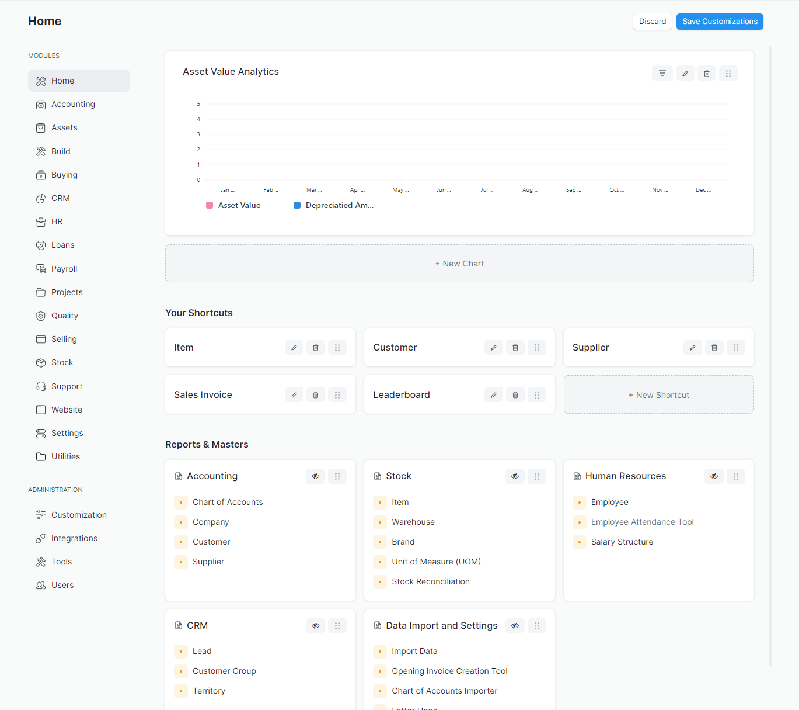
Screenshots

Slide 28
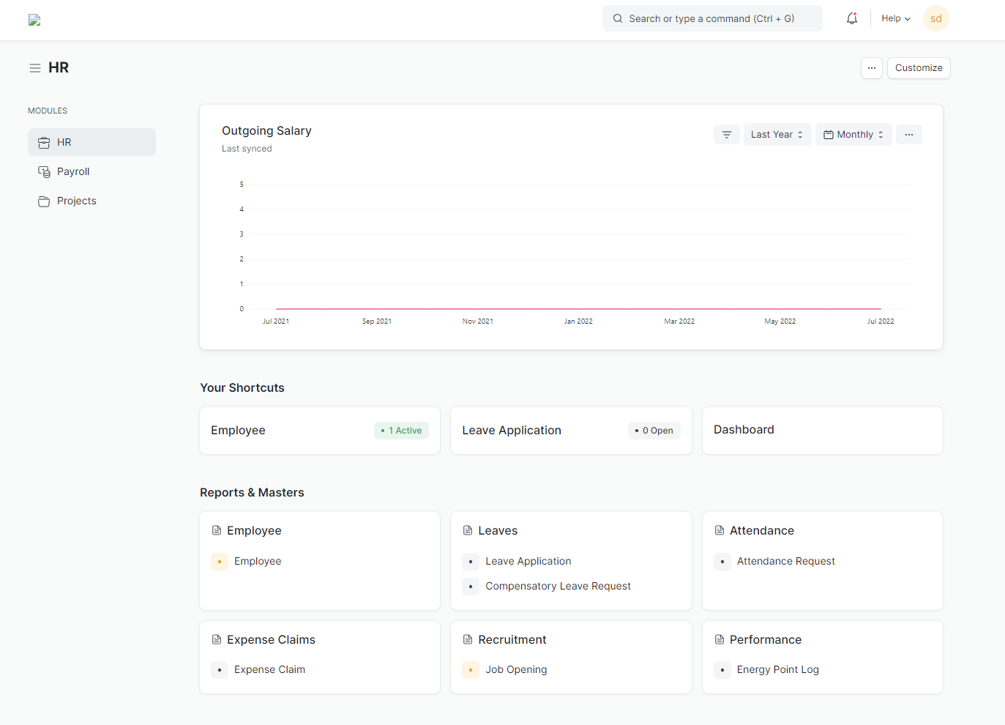
HR Module

Slide 29
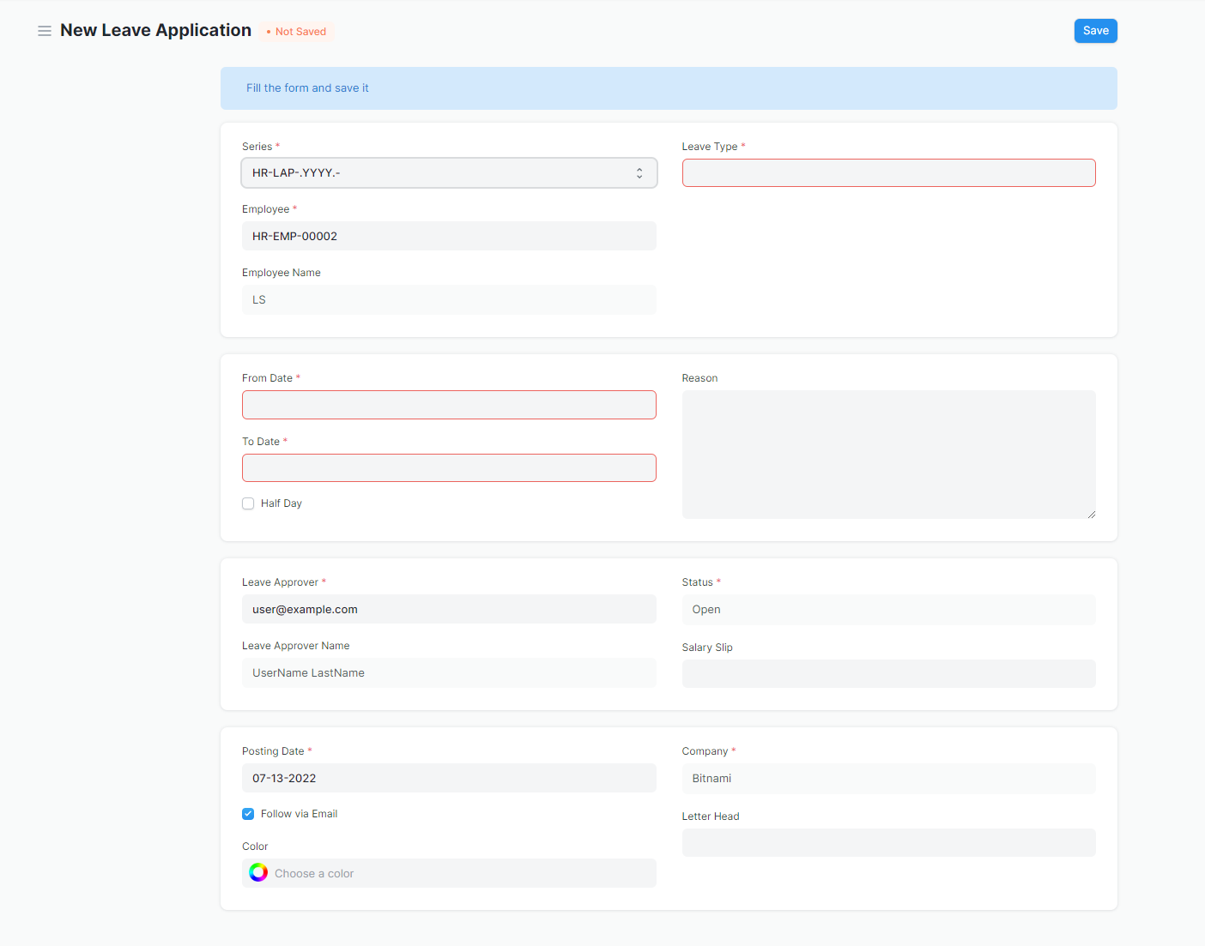
Sample Leave Application

Slide 30
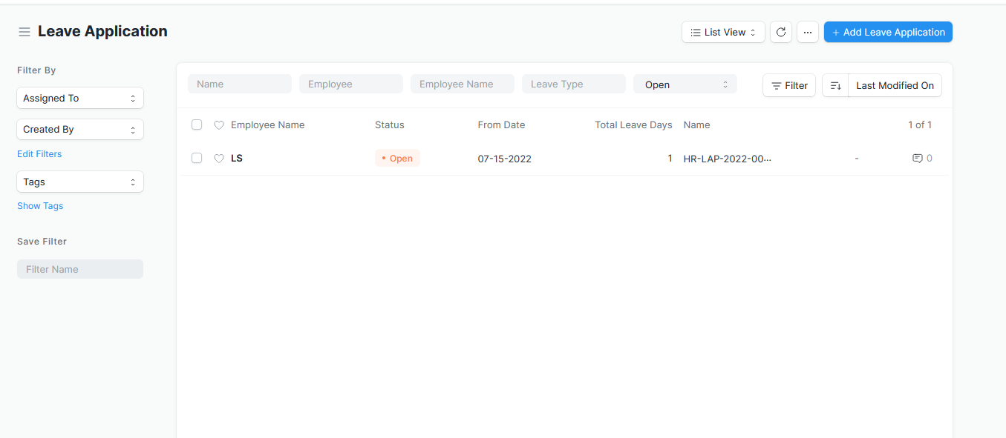
Leave Approval

Slide 31
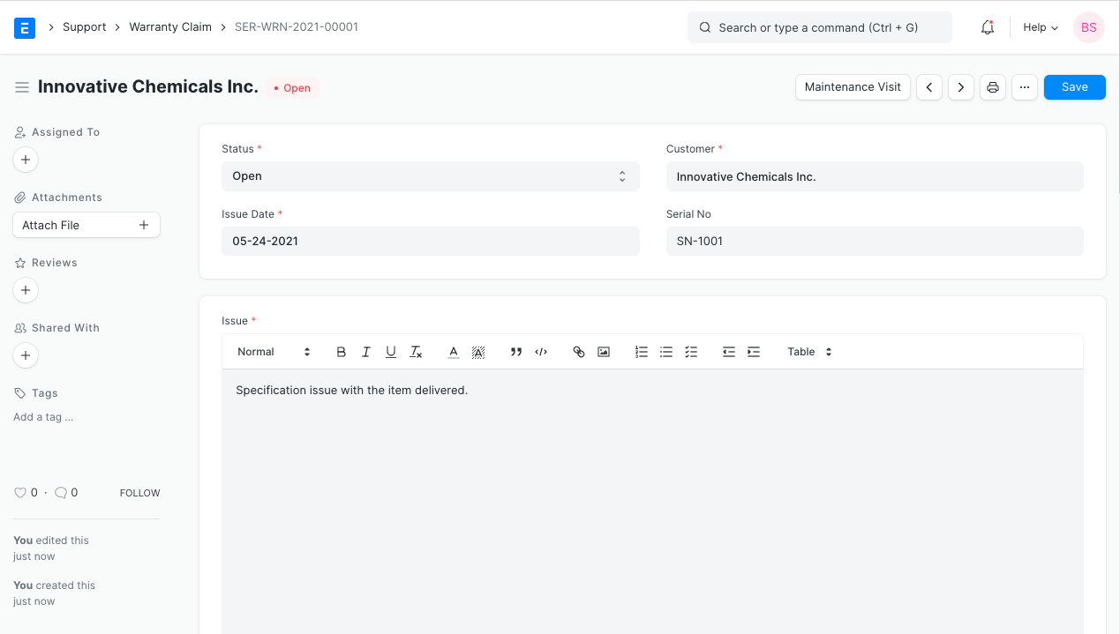
Service

Slide 32
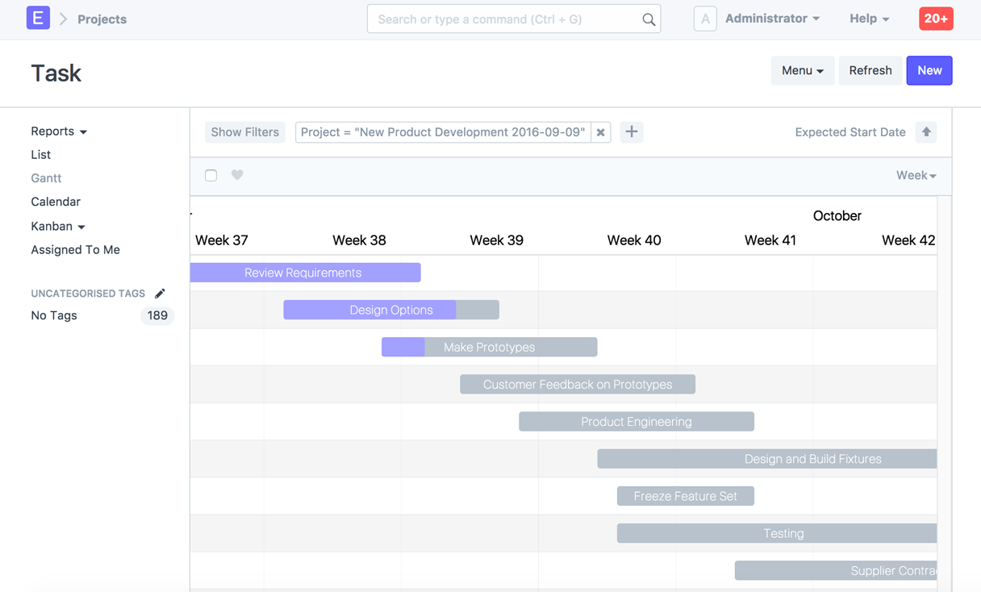
Project Management

Slide 33
